Slide 1

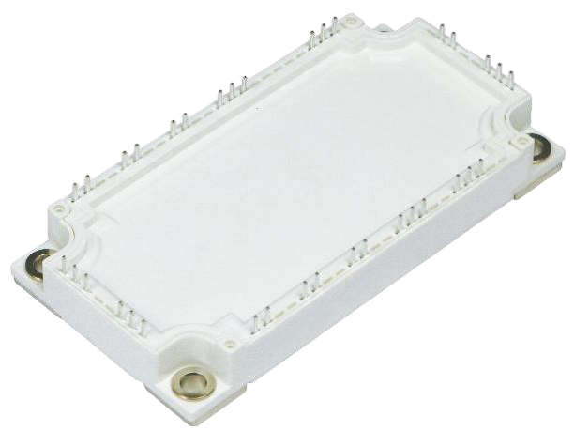

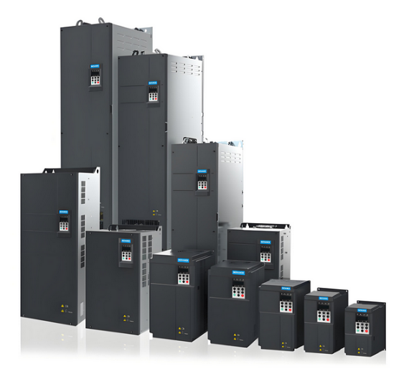
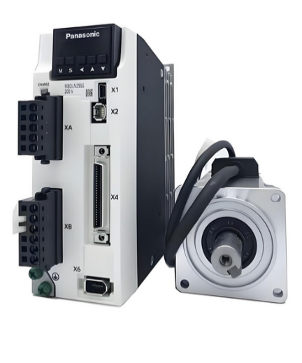

新 品
发 布
Econo 3系列 IGBT模块，变频伺服领域“平替黑马”
1. 低开关损耗；
2. 具有正温度系数的低VCE(sat) IGBT；
3. 最大电流输出能力高达200A（相同封装）；
4. 具有强雪崩耐受能力；
5. 具有大dv/dt可控范围；
6. 最高结温175℃；
产 品
特 点
更多产品详见官网
Product Name | V_{ces}(V) | lc(A) | V_{geth}(V) | V_{cesat}(V) | tr（ns） | tf（ns） | V_{f}(V)
MG50P12MLE2 | 1200 | 50 | 5.8 | 1.70 | 134 | 230 | 1.95
MG75P12MLE2 | 1200 | 75 | 5.9 | 1.60 | 31 | 255 | 2.25
MG100P12MLE2 | 1200 | 100 | 5.9 | 1.60 | 31 | 201 | 1.85
MG150P12MLE2 | 1200 | 150 | 6.0 | 1.67 | 80 | 182 | 2.10
产品介绍
扬杰科技新推出对标英飞凌7代技术的IGBT PIM模块产品，该产品采用最新的第七代微沟槽技术，相较于传统沟槽产品，其具备更高的电流输出能力，更低的损耗和更高的运行结温。经过整机系统端验证，与英飞凌的产品性能极为接近，完全可做为英飞凌的替代产品使用。
典 型
应 用
变频器
伺服驱动器
新品发布

Slide 2
NEW
PRODUCT
Econo 3 Series IGBT Modules for Variable Frequency Servo
1. Low switching loss;
2. Low VCE(sat) with positive temperature coefficient;
3. Maximum current output capability up to 200A (same package);
4. Strong avalanche tolerance;
5. A large dv/dt controllable range;
6. Maximum junction temperature is 175°C ;
Product Features
Please refer to the official website for more products
Product Name | V_{ces}(V) | lc(A) | V_{geth}(V) | V_{cesat}(V) | tr（ns） | tf（ns） | V_{f}(V)
MG50P12MLE2 | 1200 | 50 | 5.8 | 1.70 | 134 | 230 | 1.95
MG75P12MLE2 | 1200 | 75 | 5.9 | 1.60 | 31 | 255 | 2.25
MG100P12MLE2 | 1200 | 100 | 5.9 | 1.60 | 31 | 201 | 1.85
MG150P12MLE2 | 1200 | 150 | 6.0 | 1.67 | 80 | 182 | 2.10
Product Introduction
Yangjie Technology has launched a new IGBT PIM module product that benchmarks Infineon's 7th generation technology, which adopts the latest 7th generation micro-trench technology, which has higher current output capability, lower loss and higher operating junction temperature than traditional trench products. After the system-side verification of the whole machine, the performance is very close to that of Infineon's products, and it can be used as a replacement product for Infineon.
Typical
Applica
-tions
New Product Launch
frequency converter
Servo Driver

